Slide 1
Employee attrition prediction
Presented by
Thanh Vinh Giang (ALVIN)
Mason seifaddini
Rekha renukappa
Uma Selvaraj

Slide 2


Slide 3

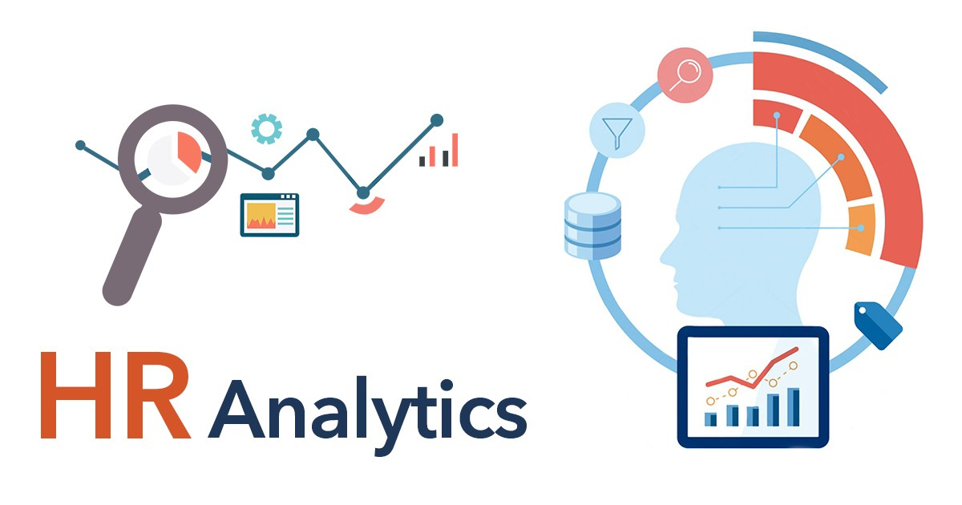
What is HR analytics ?
HR analytics is the process of collecting and analyzing Human Resources (HR) data in order to improve an organization’s workforce performance. The process can also be referred to as talent analytics, people analytics, or even workforce analytics.
This method of data analysis takes data that is routinely collected by HR and correlates it to HR and organizational objectives. Doing so provides measured evidence of how HR initiatives are contributing to the organization’s goals and strategies.
Notes:
HR analytics is the process of collecting and analyzing Human Resources (HR) data in order to improve an organization’s workforce performance. The process can also be referred to as talent analytics, people analytics, or even workforce analytics.

Slide 4


Objective
Employee attrition is the rate at which employees leave a company. The goal of this analysis is to model employee attrition and determine the most dominant contributing factors that govern this turnover. Through this kind of analysis, we can understand how many employees are likely to leave, while also determining which employees are at the highest risk and for what reasons.
Notes:
Employee attrition is the rate at which employees leave a company. This analysis aims to predict turnover and identify key factors contributing to it, helping to understand who is most likely to leave and why.

Slide 5
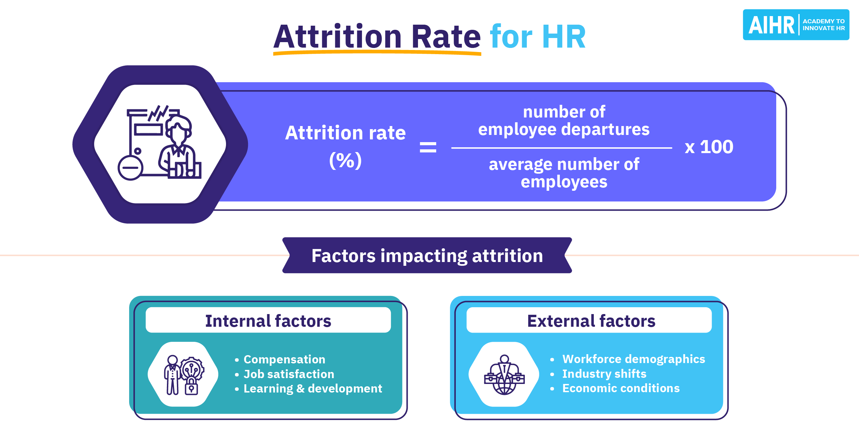
What are the statistics for employee attrition?
The average employee turnover rate in Australian workplaces, for the 12 months to the end of October 2023, was 14%.
Notes:
This is calculated with a formula.

Slide 6

Motivation
The project stems from the potential to improve employee satisfaction, reduce costs, enhance organizational performance, and create a positive workplace culture. It's an opportunity to use data and analytics to make meaningful changes that benefit both employees and the organization as a whole.
Notes:
The project aims to improve employee satisfaction, reduce costs, and enhance organizational performance by using data to create a positive workplace culture. It's an opportunity to make changes that benefit both employees and the organization.

Slide 7
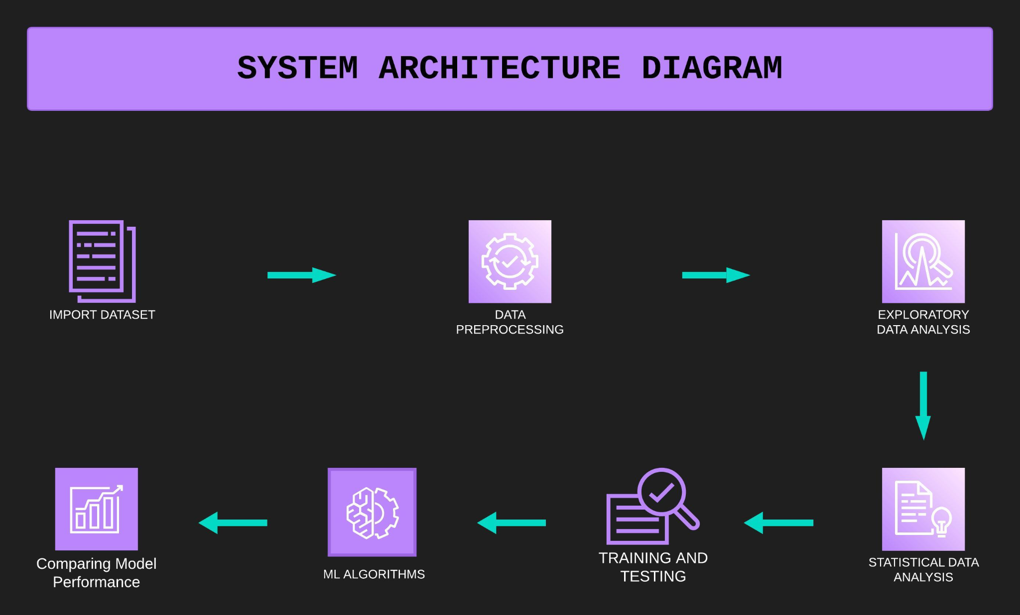

Slide 8


https://www.kaggle.com/datasets/patelprashant/employee-attrition
The dataset on employee attrition from Kaggle contains 35 columns and 1,470 rows.
Key Features of the Dataset:
Demographics: Includes attributes like age, gender, marital status, and education level.
Job-related Information: Includes job role, job satisfaction, work-life balance, and job level.
Compensation: Includes salary information, stock options, and years at the company.
Performance Metrics: Performance rating and training times.
Attrition Label: Indicates whether an employee left the company (attrition) or stayed.
Potential Uses:
Attrition Prediction: The dataset is commonly used to build machine learning models that predict whether an employee is likely to leave based on various factors.
Feature Importance: Helps identify the most important factors contributing to employee attrition.
Employee Retention Strategies: Insights from the analysis can help HR departments design better retention strategies.

Slide 9
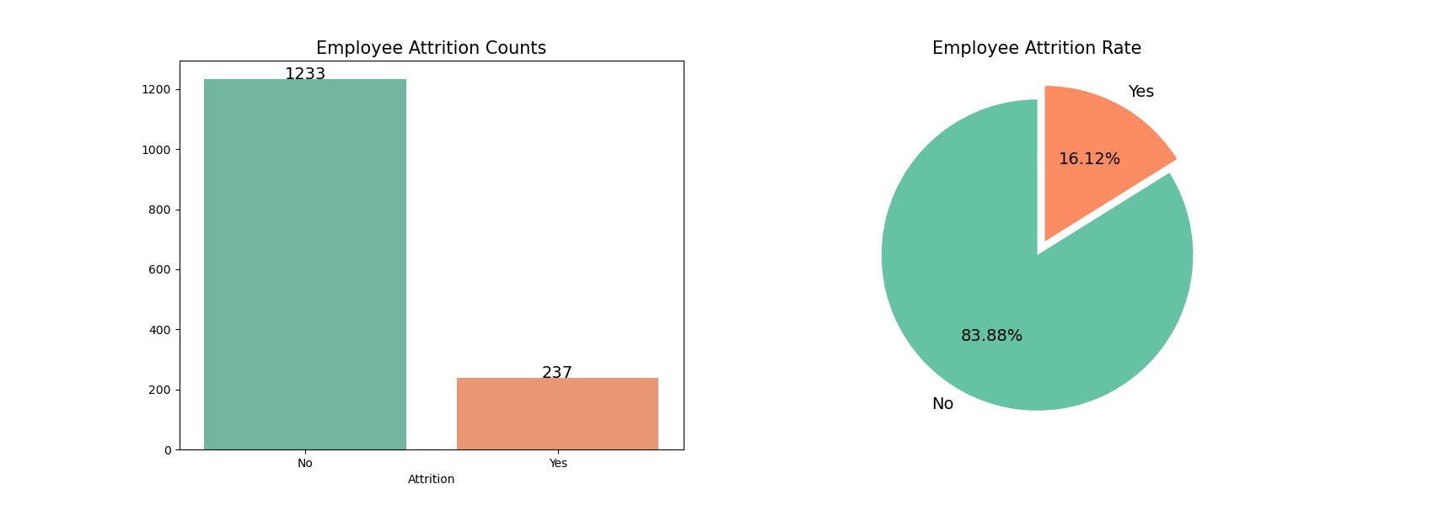
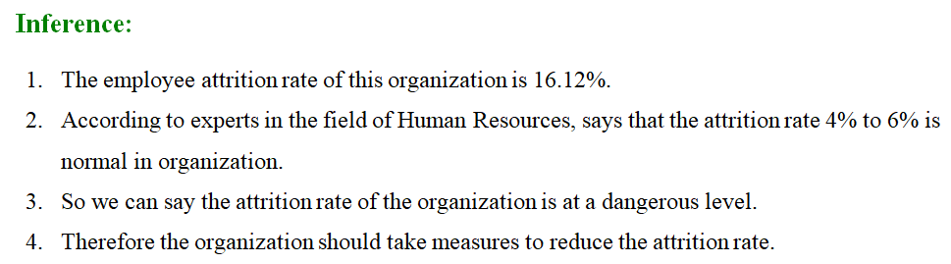

Slide 10
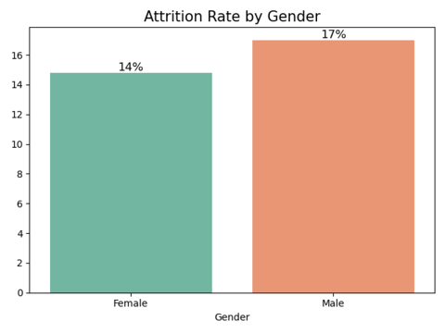
- A 16.12% attrition rate may indicate that the organization has a relatively stable workforce but still faces challenges in retaining a certain percentage of its employees. - The attrition rate among males is 17.01%, slightly higher than the overall rate. - The attrition rate among females is 14.80%, which is lower than the overall rate and the male attrition rate.

Slide 11
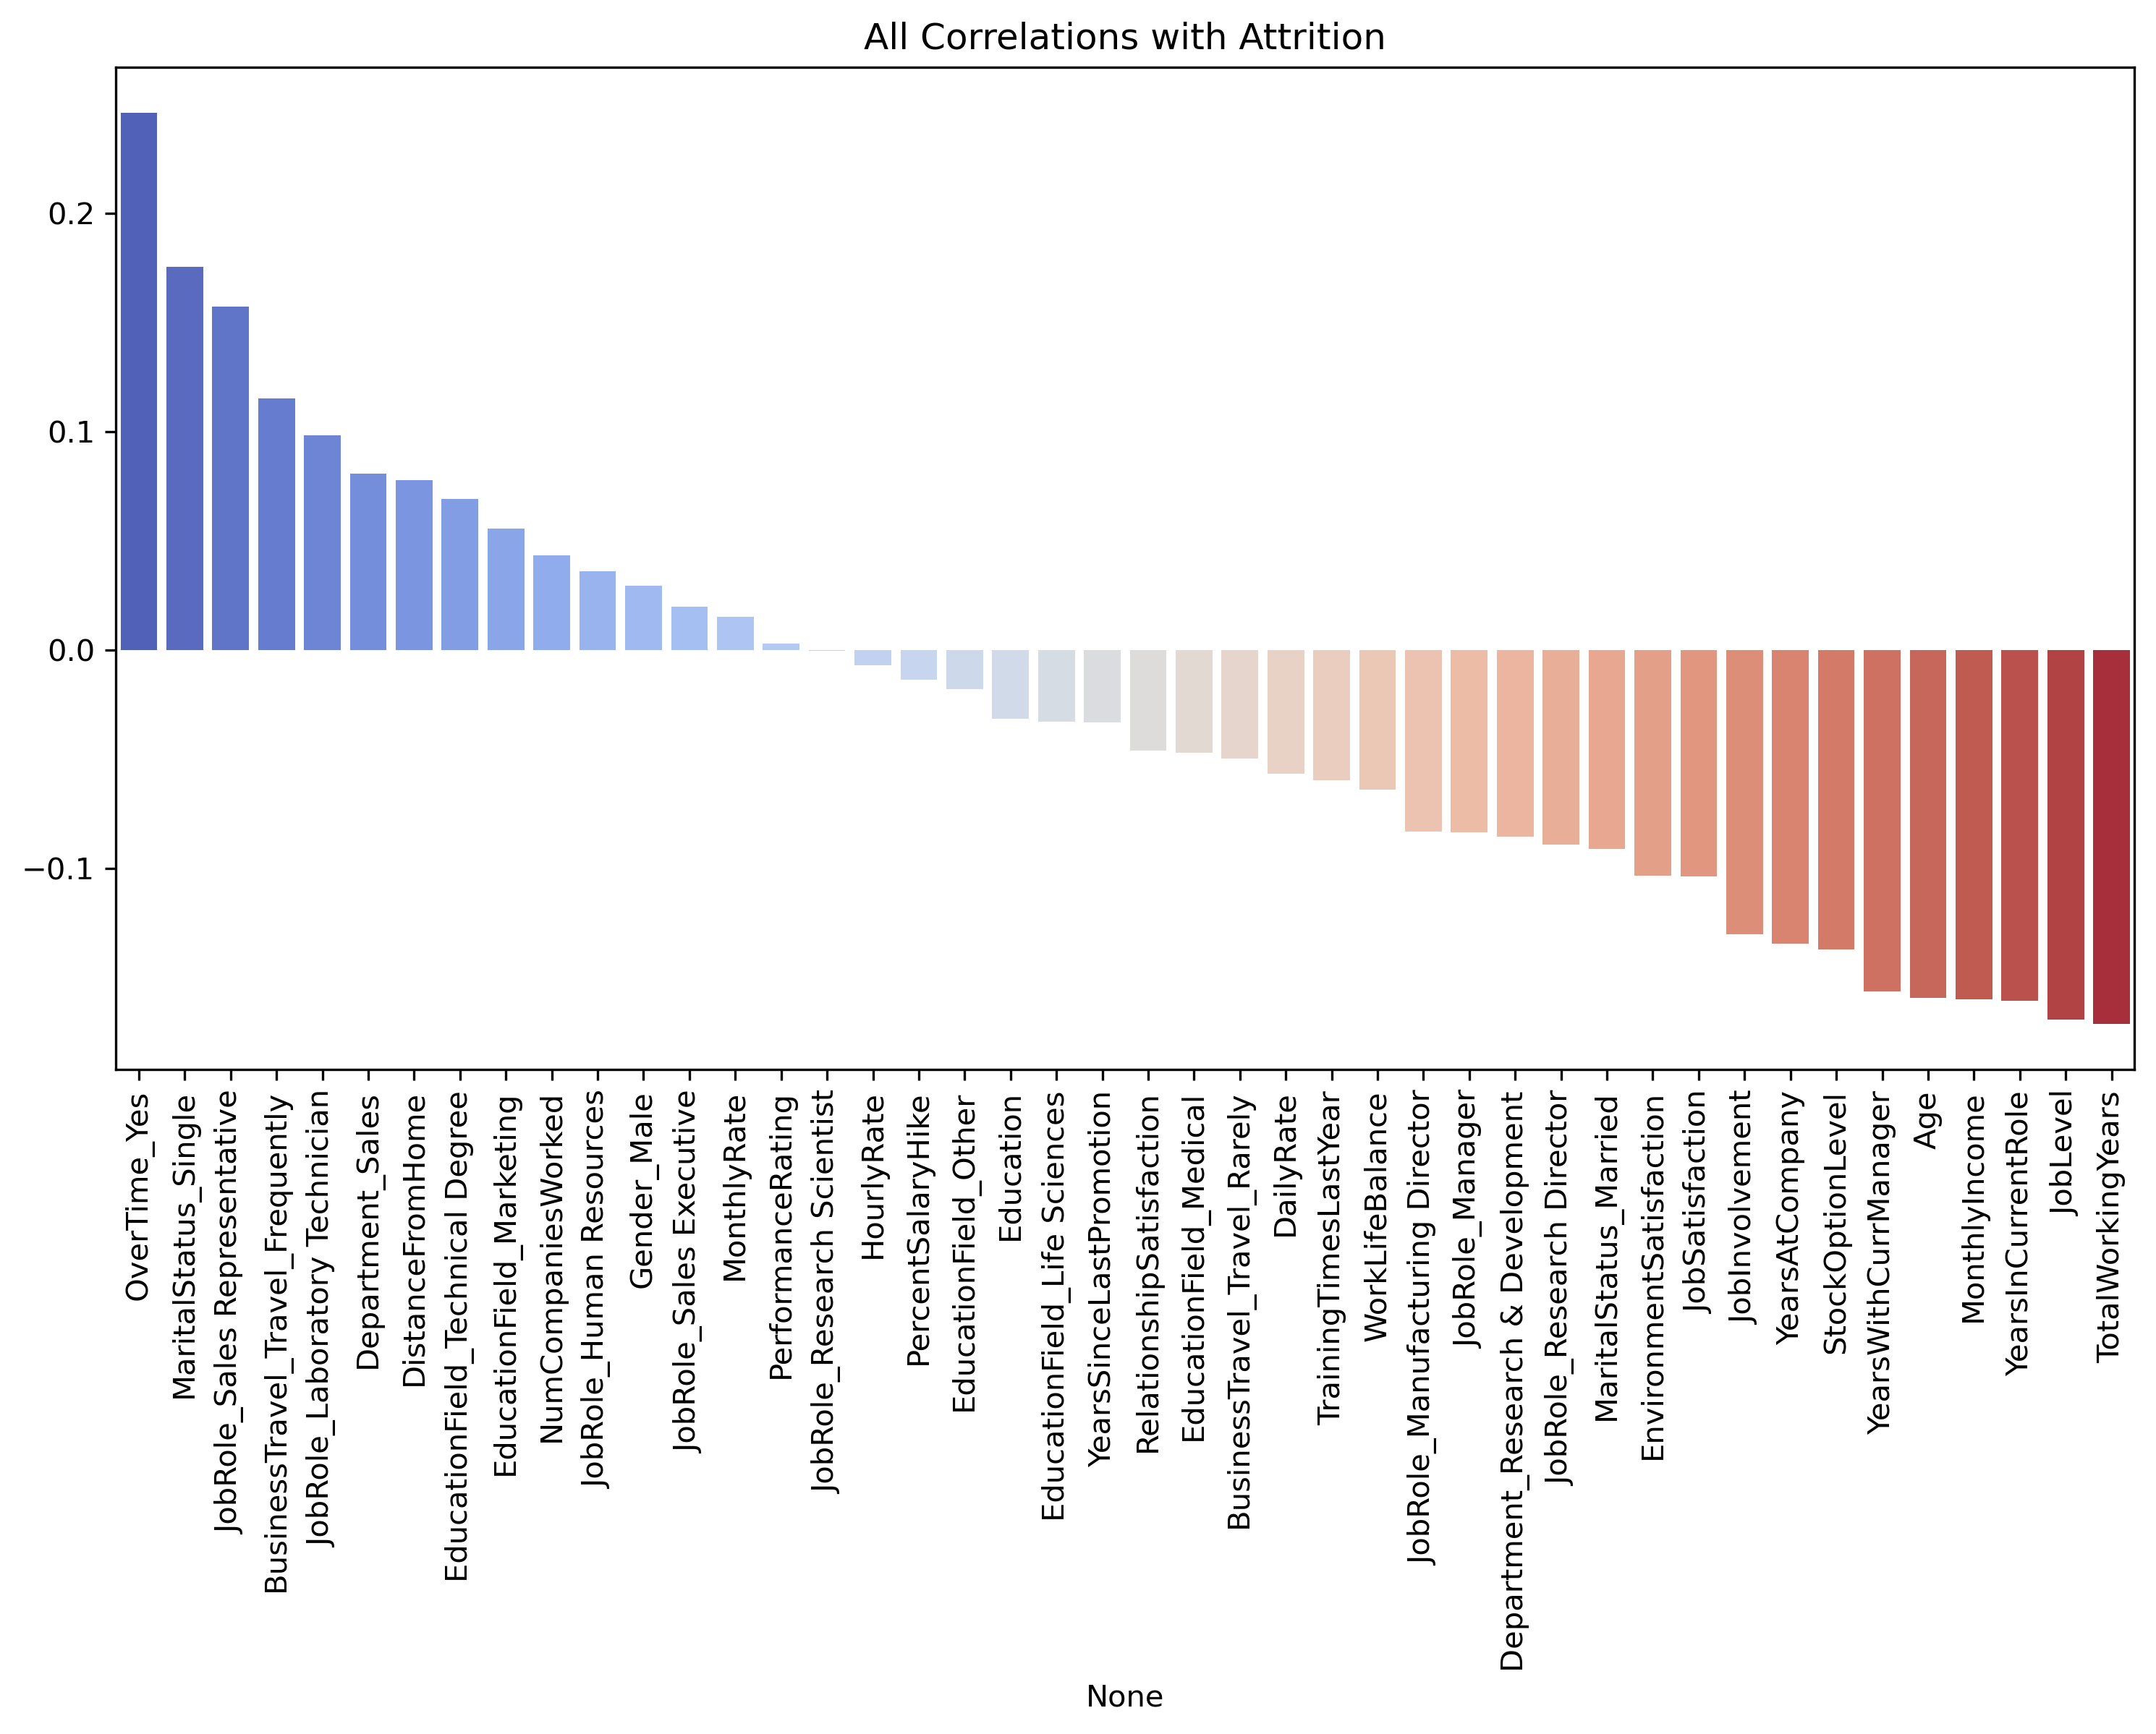
All Correlations with Attrition
Correlation analysis shows the influence of various factors on attrition, with variables like overtime and job role being significantly correlated.

Slide 12
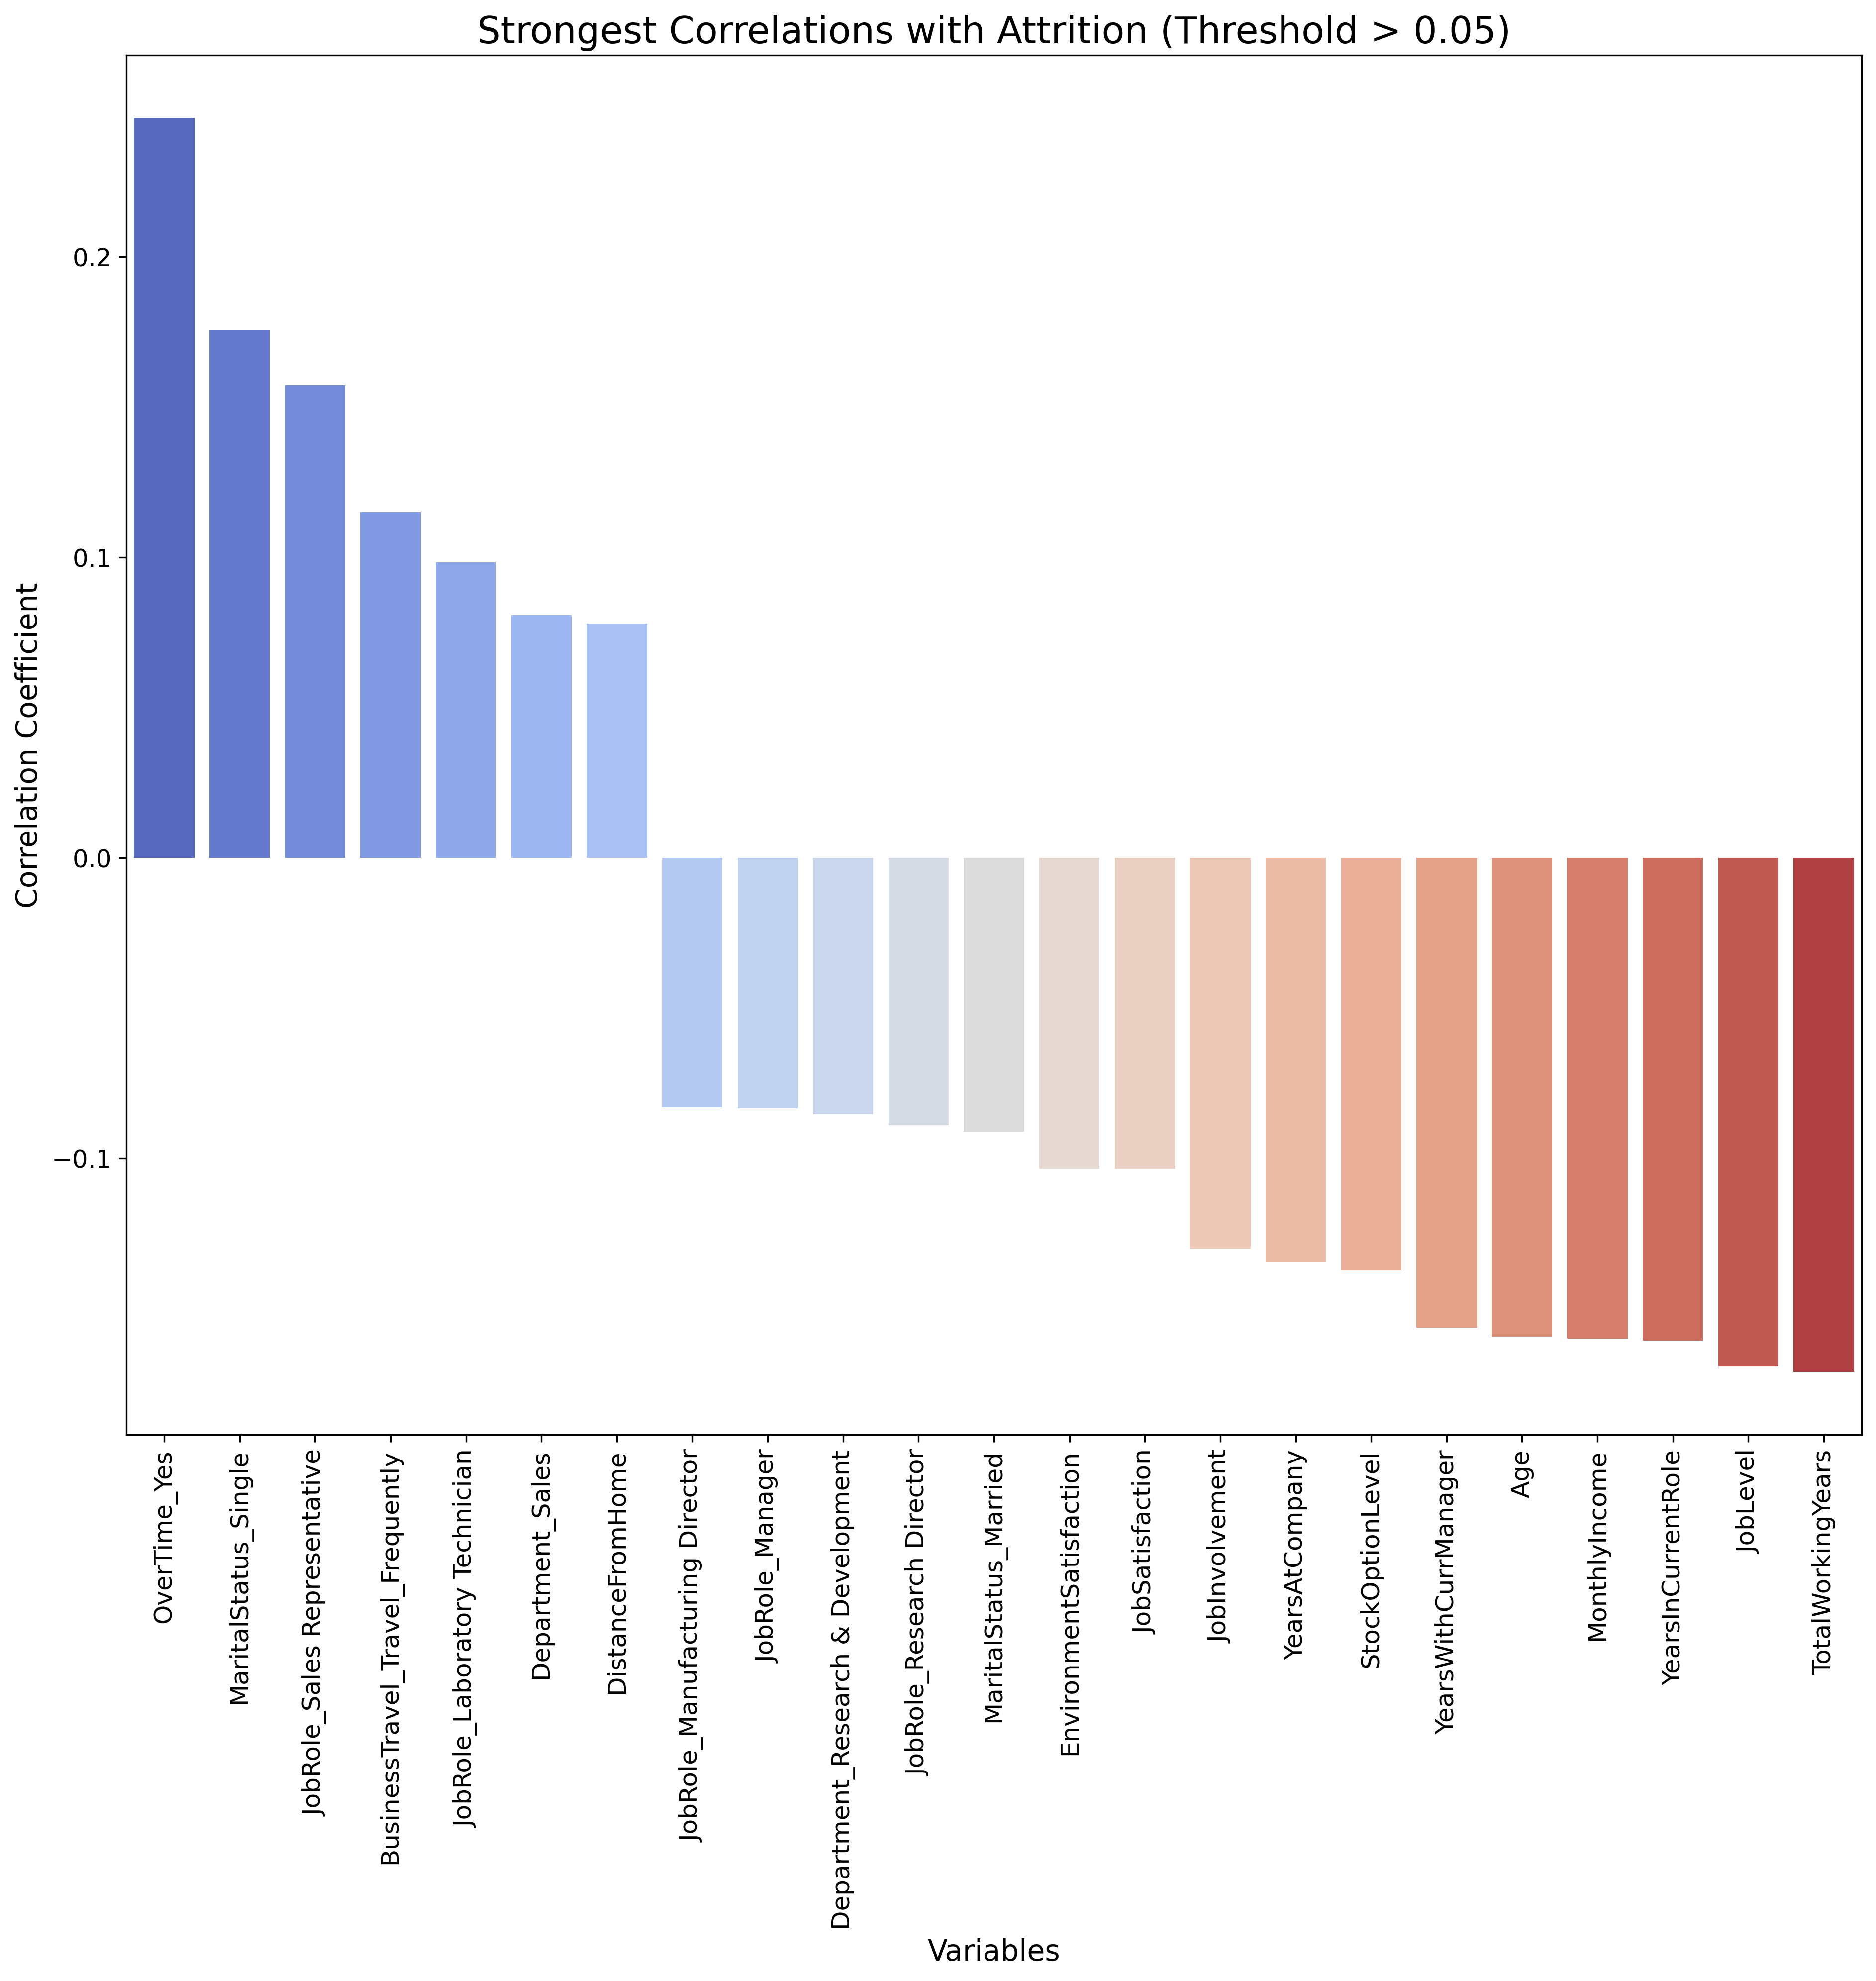
Strongest Correlations with Attrition (Threshold > 0.05)
Filtering for stronger correlations reveals key factors like overtime, marital status, and specific job roles impacting attrition.

Slide 13
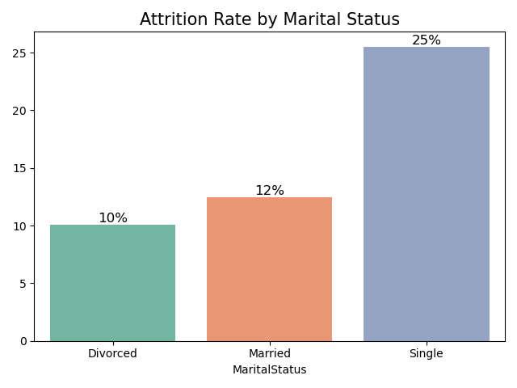
Attrition Rate by Marital Status
Single employees have the highest attrition rate, suggesting marital status plays a role in employee retention.

Slide 14
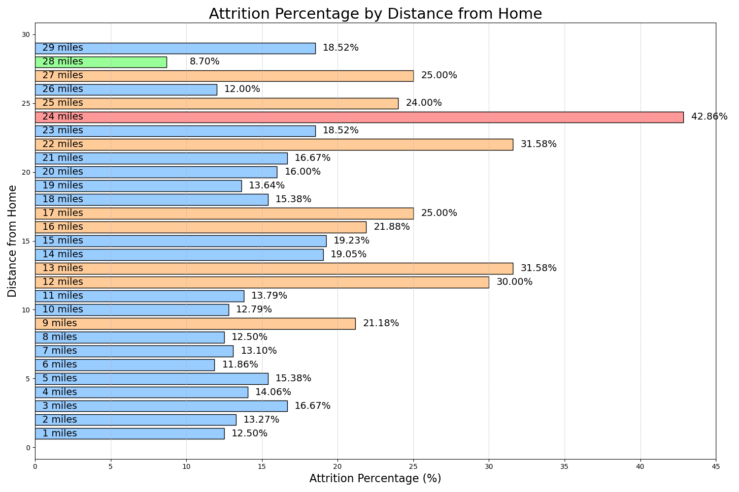
Attrition Percentage by Distance from Home
Distance from home shows mixed impact on attrition, with some living far having low attrition rates, indicating other factors might override distance.

Slide 15
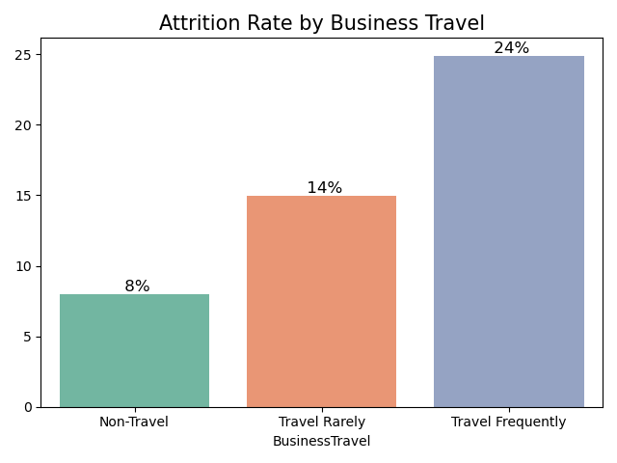
Attrition Rate by Business Travel
Frequent business travel is linked to higher attrition, emphasizing the strain of frequent travel on employees.

Slide 16
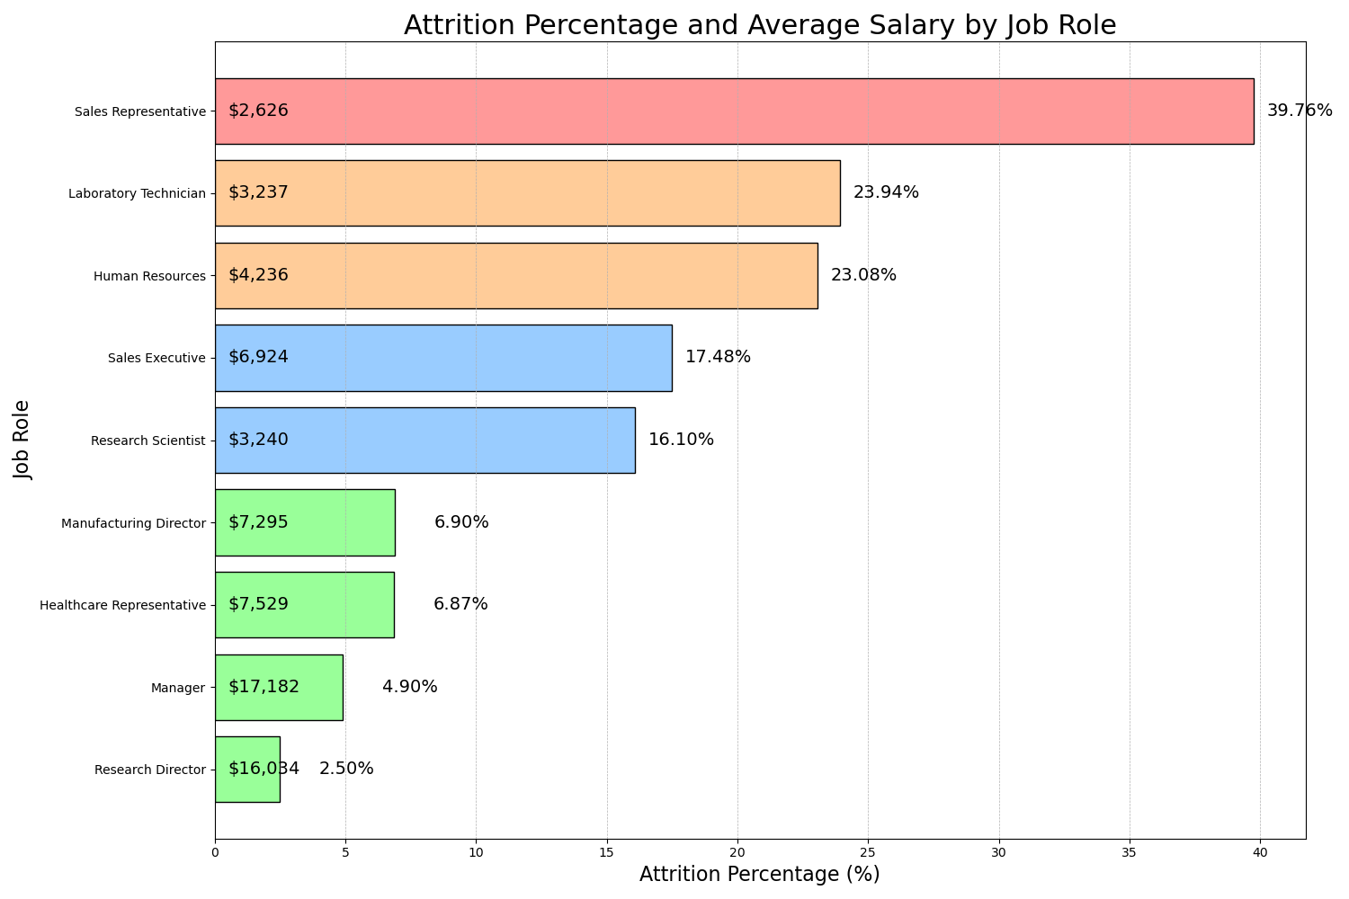
Attrition Percentage and Average Salary by Job Role
Sales roles, particularly Sales Representatives, have the highest attrition, possibly due to lower average salaries.

Slide 17
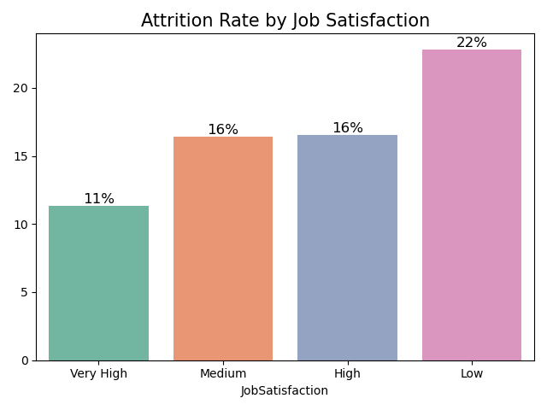
Attrition Rate by Job Satisfaction
Low job satisfaction strongly correlates with higher attrition, underscoring the importance of employee engagement.

Slide 18
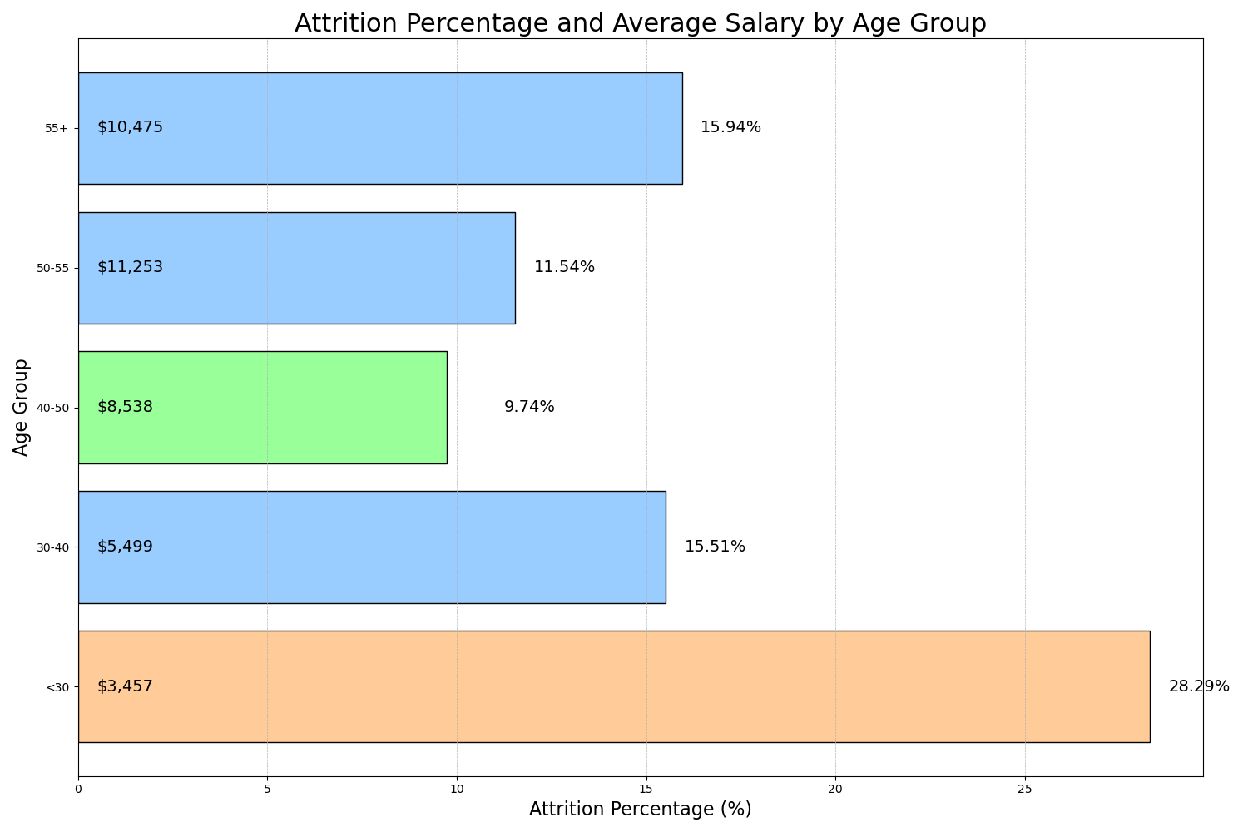
Attrition Percentage and Average Salary by Age Group
Younger employees (<30) show the highest attrition, often linked to lower salaries and career growth opportunities.

Slide 19
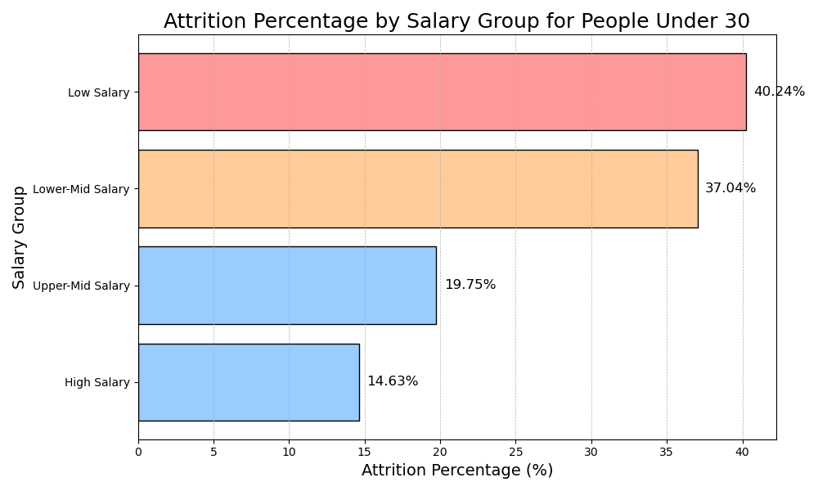
Attrition Percentage by Salary Group for People Under 30
Lower salary groups under 30 show significantly higher attrition, emphasizing the need for competitive compensation.

Slide 20
Machine Learning
1. Preprocessing:
Encode categorical variables.
Split the data into features (X) and target (y).
Perform a train-test split.
2. Model Training:
Train a Random Forest classifier.
Perform hyperparameter tuning using GridSearchCV.
3. Evaluate the Model:
Assess the model's performance using metrics like accuracy, precision, recall, and F1-score.
4. Feature Importances:
Extract and visualize the feature importances from the trained model.
Balance the dataset using SMOTE

Slide 21
Preprocessing
Encode
Encode categorical variables.
Balance
Create synthetic examples of minority class using SMOTE
Split
Split the data into features (X) and target (y).
Perform
Perform a train-test split.
70% train
30 test
20% Attrition Yes
80% Attrition No

Slide 22
Model Training
Model Choice:
Random Forest classifier
Hyperparameter Tuning:
GridSearchCV includes:
The best hyperparameters:
Handle both numerical and categorical features.
Provides insights into feature importances
number of trees (n_estimators)
n_estimators = 100,
max_depth = 30,
min_samples_split = 2,
min_samples_leaf = 1.
maximum tree depth (max_depth),
minimum samples required to split a node (min_samples_split),
minimum samples required at a leaf node (min_samples_leaf).
An ensemble learning algorithm.
Constructing multiple decision trees

Slide 23
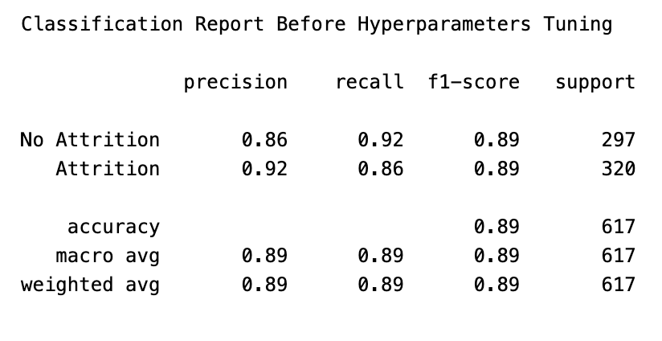
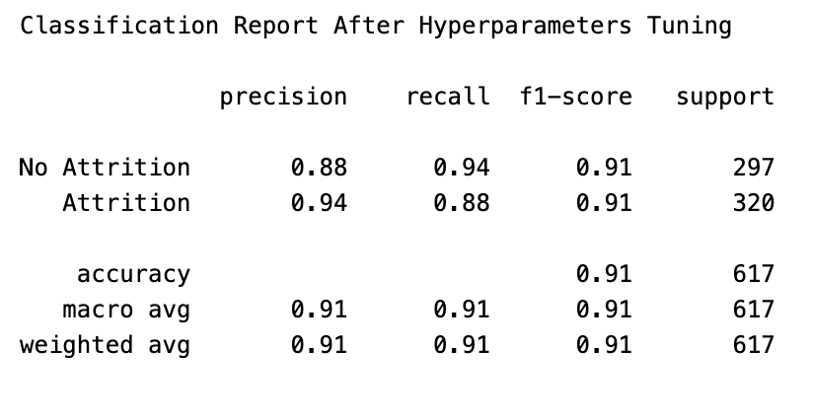
Evaluate the Model
Before
After

Slide 24
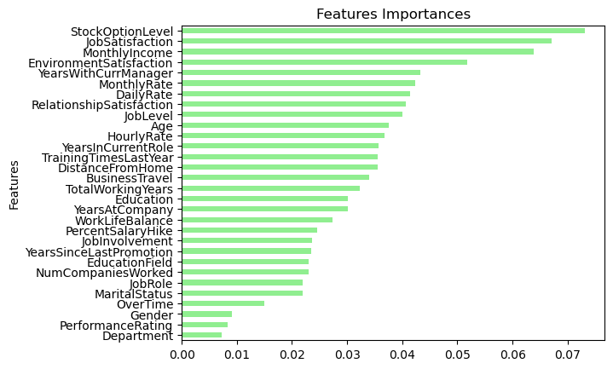
Feature Importances

Slide 25
Deploy the model using Gradio

Slide 26
Summary of Findings:
The Random Forest has a high accuracy score at 91%
The Random Forest model has identified key factors contributing to employee attrition, with Stock Option Level and Job Satisfaction being the most influential.
Practical Implications:
HR departments should consider focusing on competitive salary packages and monitoring overtime hours to reduce attrition. Younger employees might benefit from targeted retention programs.
Next Steps:
To further improve the model, exploring other models like Gradient Boosting Machines or tuning more hyperparameters could yield better results.

Slide 27
CONCLUSION
In conclusion, we embarked on a comprehensive analysis of Analytics Attrition Dataset, from data loading to model evaluation.
By implementing and evaluating various machine learning algorithms, we gained insights into which models are effective for predicting employee attrition.
The results and visualizations generated throughout the process provide valuable information for decision-makers and professionals seeking to understand and mitigate employee attrition within the organization.
This project showcases the power of data analysis and machine learning in addressing real-world business challenges.

Slide 28
Thank you

